Slide 1
IMDB Exploratory Lab
Movie Popularity
Genres, Movie Ratings, Vote Counts

Slide 2
Initial Data Exploration Findings
The genres Drama and Biography appear frequently among the highest-rated movies, suggesting these genres resonate well with audiences.
Movies with fewer than 1,000 votes tend to have unreliable average ratings due to low sample size, so filtering these improves data quality.
Many movies list multiple genres together, which complicates analysis and suggests the need for separating genre categories for clearer insights.

Slide 3
Business Question for Further Analysis
Which genres are most consistently associated with high-rated, widely-rated movies?
This research could be valuable for streaming services or production companies looking to invest in content pertaining to movie production and or hosting movies on their platforms.
By filtering for movies with more than 1,000 votes, we highlight genres that are both popular and well-received.
Chart reveals that genres like Drama and Biography dominate top-rated films with high engagement.

Slide 4
Data Cleaning Considerations
Cleaned data by removing low vote count entries and focusing on recent (2010–2019) movies.
Future work could analyze how individual genres trend over time or vary by region.

Slide 5
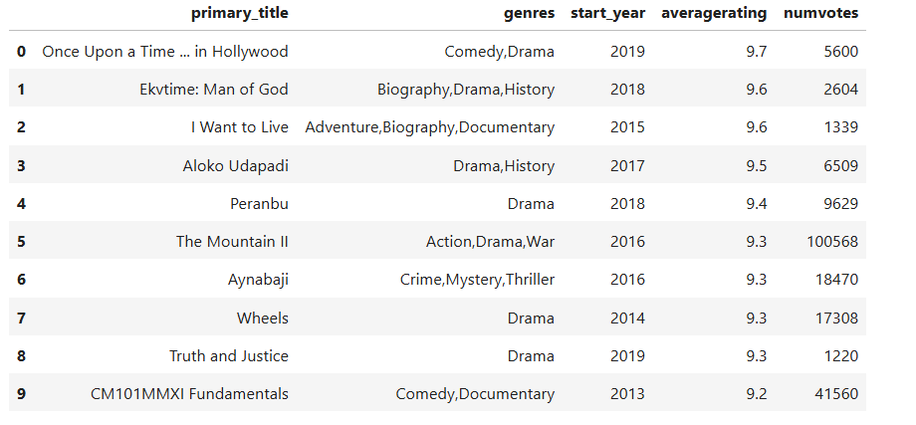
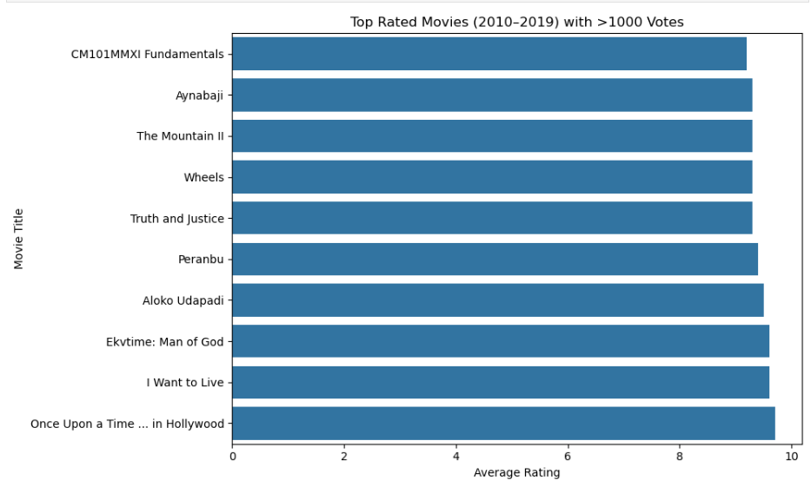
Visualizations

